Slide 1
Living the Call- The Lay Vocation at Work
Presenters: William E. Simon Jr.
Cambria Smith
Los Angeles Religious Education Congress
March 23rd, 2012

Slide 2
Overview
Introduction
Bill’s Story
Overview of “Living the Call”
How the book has been received
The need for lay ecclesial ministers
Archdiocese of Los Angeles Model
Parish Life Directors
Cambria’s Story

Slide 3
Notes:
The Dedication Mass of Holy Family Church, South Pasadena on Easter Sunday, April 28th, 1928

Slide 4
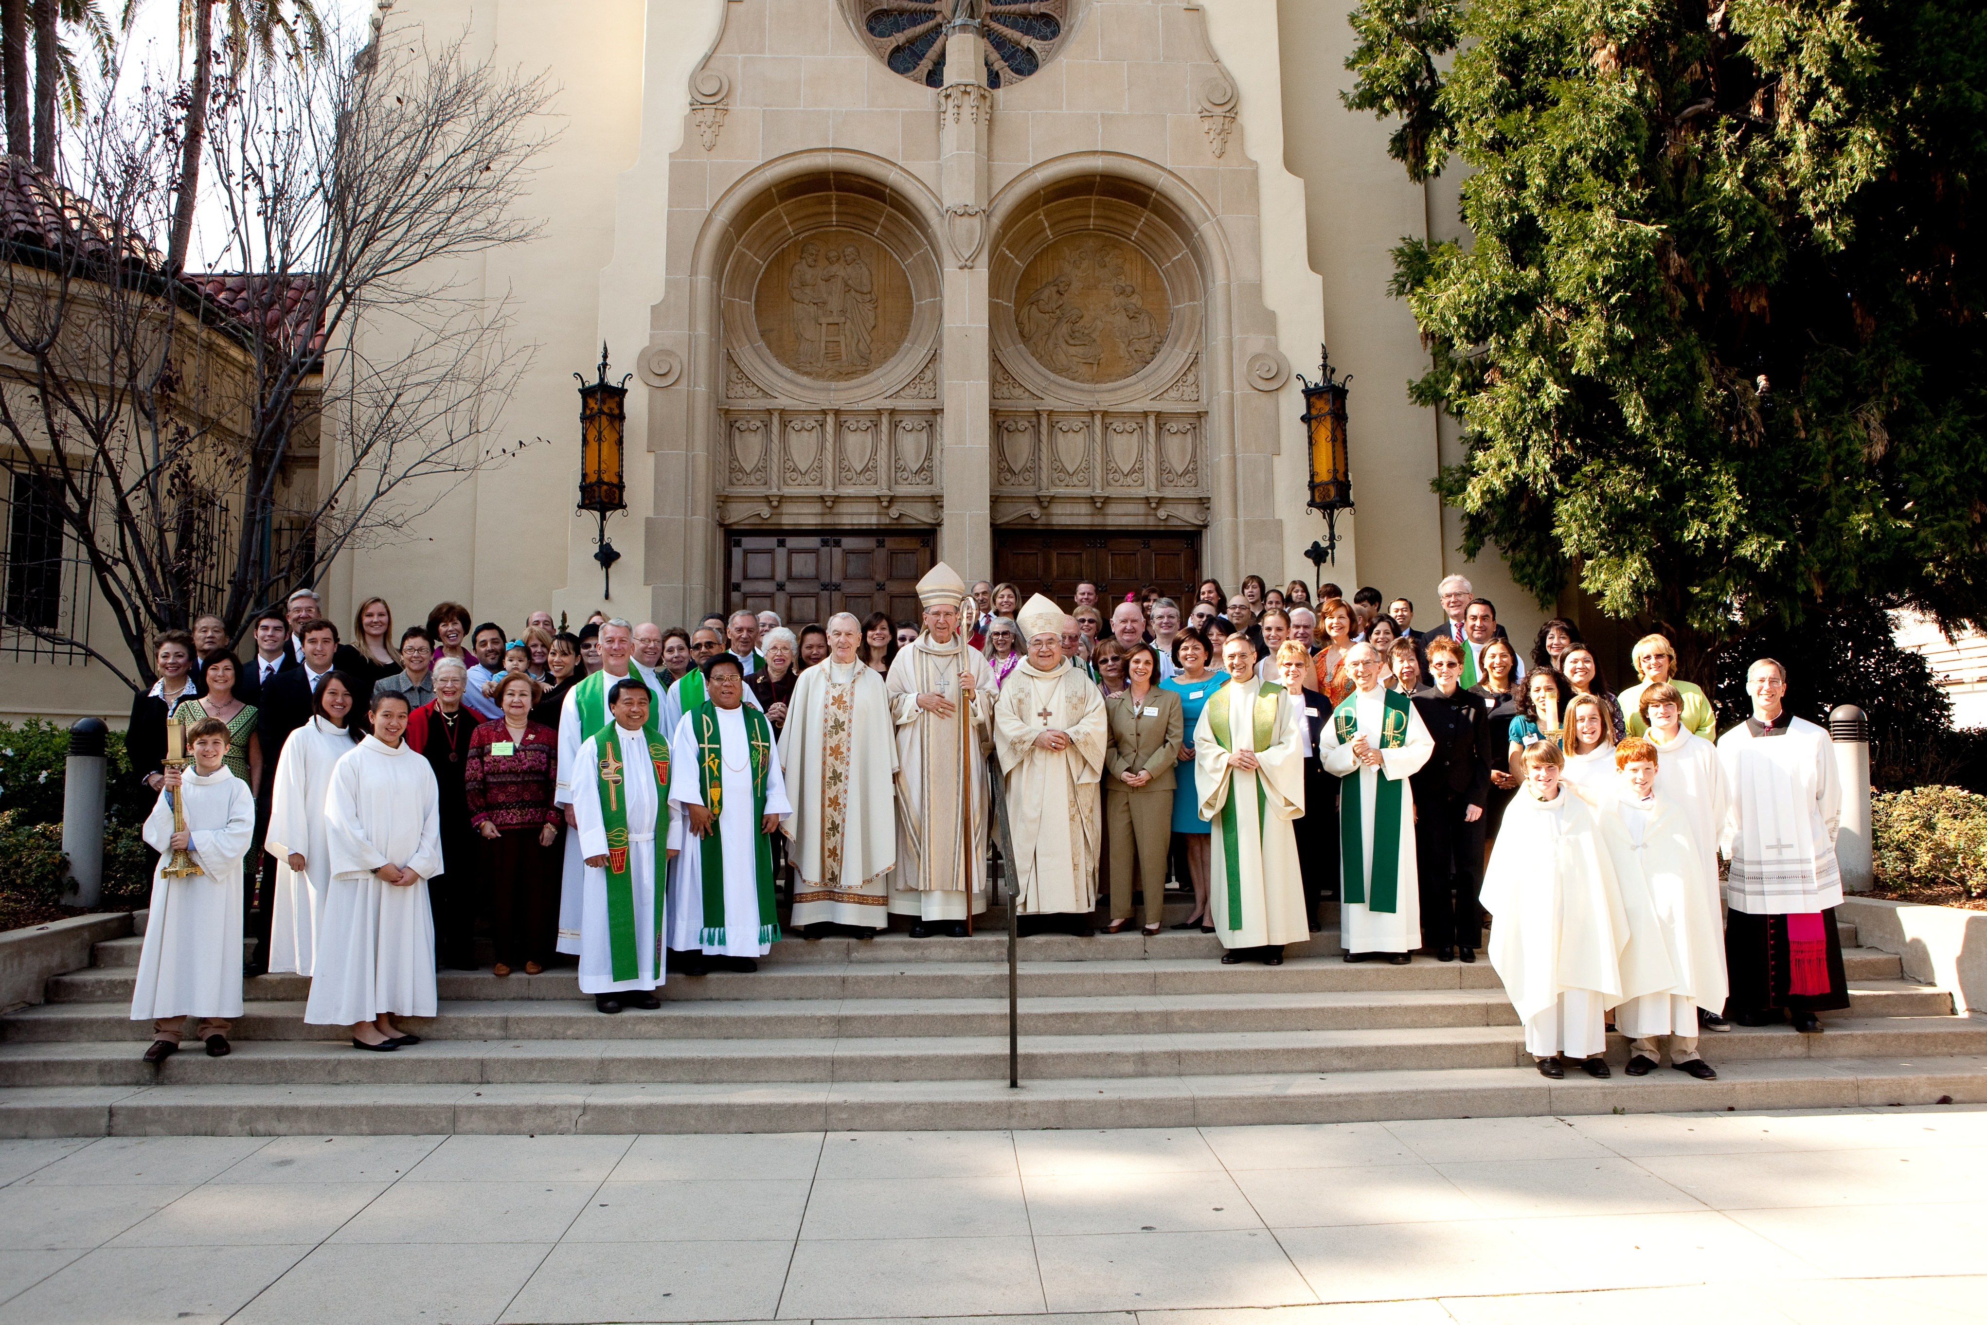
Notes:
The Centennial Mass, January 31st, 2010 at Holy Family Church, South Pasadena

Slide 5
Two Interesting Pictures
Fundamental Changes
Pre and Post Vatican II

Slide 6
Introduction
This workshop will explore the opportunities for lay people and the challenges facing the Catholic Church in the coming years consistent with God’s call to lay people to be priests, prophets and kings.

Slide 7
Why is the lay vocation important?
1. It is our baptismal call!
2. We need lay ecclesial ministers!!!

Slide 8
As the People of God, what is our baptismal call?

Slide 9
The Documents of Vatican II tell us that:
▫ Every Christian has been made a sharer in “the priestly, prophetic, and kingly functions of Christ,” *
and
▫ Their apostolate “is a participation in the saving mission of the Church itself…
and
▫ “All are commissioned to that apostolate by the Lord Himself.” **
* Second Vatican Council: Constitution Lumen Gentium: #31
** Ibid. #33

Slide 10
ABOUT THE LAITY:*
As sharers in the role of Christ as priest, prophet and king, the laity have their work cut out for them in the life and activity of the Church.
Their activity is so necessary within the Church communities that without it the apostolate of the pastors is often unable to achieve its full effectiveness.
In the manner of the men and women who helped Paul in spreading the Gospel (cf. Acts 18:18, 26; Rm 16:3), the laity with the right apostolic attitude supply what is lacking to their brethren and refresh the spirit of pastors and of the rest of the faithful (cf. 1 Cor 16:17-18).
Strengthened by active participation in the liturgical life of their community, they are eager to do their share of the apostolic works of that community.
* Second Vatican Council: Decree on the Apostolate of the Laity: #10

Slide 11
Bill’s Story
Cradle Catholic, eldest of 7 children
Prodigal Son: “He was lost and is found”
Material Success
I was a “box checker”

Slide 12
Bill’s Story
Something was missing
Feeling that family, faith and careers should not be separate

Slide 13
Bill’s Story
New Year’s Resolutions – Soft inkling; no thunderbolt
My pastor Lloyd Torgerson
My friend Bob Buford
Michael Novak – life changing dialogue

Slide 14
Bill’s Story
What I realized….
Being Catholic is a choice, not a birthright. To really be a Catholic, you have to participate.

Slide 15
Overview of “Living the Call”
Our research showed us 2 things
Initial thesis was wrong
Days of pray, pay and obey were over

Slide 16
Overview of “Living the Call”
3 Underlying Purposes
Celebrate the Catholic Church
Encourage lay vocations… Ordinary Catholics can make extraordinary contributions to the life of the Church
Tap into the energy among lay people…the call to serve God in the secular world, and to deepen your relationship with God in the spiritual world.

Slide 17
Council Fathers of Vatican II state:
“Our modern times require of the laity…zeal:
in fact, modern conditions demand that their own apostolate be broadened and intensified.”

Slide 18
Part 1: Into the World
Abundant opportunities in the Catholic Church
The Church is an incredibly dynamic and vibrant
organization → there are tremendous opportunities
for lay people to keep the Church alive.
Three Areas; Education, Parish and Non-Parish

Slide 19
Profiles
We selected 9 people to profile
Could be 9 thousand or 9 hundred thousand
Everyday Catholic lay people
Intended to be a cross section; geographically gender-wise, age-wise

Slide 20
Profiles
People like Elias Moo a young Hispanic gentleman who is doing miraculous work teaching at the St. Rose School in Denver
People like Peter Flanigan who created a plan to increase the chances for kids in Harlem going to college from 1 in 8 to 7 in 8.
People like Cambria Smith who found her faith while sitting in a church pew in London. She saw a painting of Jesus above the altar and felt His presence and His call.

Slide 21
Common Denominators
Seekers
Attempted to Discern God’s will
Followed through on their discernment

Slide 22
Part 2:The Search Within
Michael Novak was My Spiritual Tour Guide
Rich Catholic Traditions
Two thousand years of spiritual practices
Prayer, meditation, retreats
My favorite; My Imitation of Christ, Thomas à Kempis
Notes:
Appendix:

Slide 23
Book Reviews
Unbelievable!
Conservatives and Liberals Alike
Archbishop Dolan, Archbishop Myers

Slide 24
What is the need for lay ecclesial ministers?

Slide 25
Some Catholic Statistics to make us pause…
The Pew Forum on Religion and Public Life
2010-24% of Americans are Catholic
2009- One in 10 Americans are former Catholics and one in 3 of those raised Catholic has left the Church
2008- Net loss of 7.5% of Catholics (those born Catholic but are no longer Catholic) compared to a net loss of 3.7% of Baptists

Slide 26
Weekly Mass Attendance (CARA Report, 2011)

Slide 27
A Demographic Snapshot of the Archdiocese of Los Angeles 2012

Slide 28
How many people does ADLA serve?
Number of Baptisms in 2010*
Archdiocese of Chicago: 36,688
Archdiocese of New York: 26,051
Total: 62,739
Archdiocese of Los Angeles: 84,731
(exceeds the populations of 46 Arch/Dioceses in the US)
* Source: 2011 Kenedy Directory

Slide 29
Comparative Statistics
1980
2011
278 Parishes
30 Missions
61 High Schools**
230 Elementary
Schools**
2,009,082 Catholics
287 Parishes
9 Missions
51 High Schools**
219 Elementary
Schools**
4,208,660 Catholics
We are the largest and fastest growing Archdiocese in the United States
** Includes Diocesan, Parish and Private Schools

Slide 30
Diocesan Trends 1980-2010
1980 1990 2000 2010
Permanent Deacons 91 115 179 314
Sisters 2,545 2,000 1,900 1,897
Priests :Retired, Sick, Absent 64 106 140 186
Active Diocesan Priests 488 546 426 332
Religious Priests 654 658 583 536
Extern Priests n/a 118 141 123
Pastoral Associates 0 0 0 30 (‘11)
Parish Life Directors 0 0 0 8 (‘11)
Catholics 2,009,082 3,405,180 4,121,601 4,208,660
Ratio of Catholics Dio. & Rel.: 1,759 2,828 3,584 4,849
to Priests (1:x)*
Total Archdiocesan Population 7,808,800 9,656,205 10,449,129 12,277,710
¤ 2011 Kenedy Directory Figures
* Figure DOES NOT include diocesan priests working/studying outside diocese, as well as retired priests, sick or absent

Slide 31
Ordinations vs. Retirements*
Year | Ordinations | Retirements
2003 | 4 | 6
2004 | 6 | 9
2005 | 5 | 13
2006 | 4 | 6
2007 | 6 | 9
2008 | 12 | 8
2009 | 6 | 11
2010 | 3 | 9
2011 | 6 | 13
Total | 52 | 84
*Statistics from the Archdiocese of Los Angeles which do not include deceased priests.

Slide 32
Projected
Ordinations vs. Retirements (70)
Year | Ordinations | Retirements
2012 | 5 | 11
2013 | 5 | 16
2014 | 5 | 7
2015 | 5 | 11
2016 | 5 | 11
Total | 25 | 56

Slide 33
Age Groupings of Priests, 2010
Active AD Priests (348)
30-39 30
40-49 72
50-59 115
60-69 106
70+ 25
Retired AD Priests (166)
Number of Seminarians:
1980: 232
2011: 78 (39 for LA)

Slide 34
How has the ADLA responded to these challenges?

Slide 35
Pastoral Documents
As I Have Done for You (2000)
As One Who Serves (2005)
Serving Shoulder to Shoulder (2006)

Slide 36
As I Have Done For You (2000)
On Holy Thursday 2000, the Cardinal Archbishop and priests of the Archdiocese released a Pastoral Letter on Ministry, “As I Have done for You.”
“Mere adjustment and small shifts in practice will not suffice. What is called for is a major reorientation in our thinking about ministry as well as in our ministerial practice.”
“What some refer to as a “vocations crisis” is an invitation to a more creative and effective ordering of gifts and energy in the Body of Christ.”
“It must be recognized that lay ministry rooted in the priesthood of the baptized is not a stopgap measure.”

Slide 37
As One Who Serves (2005) A Pastoral Statement on Parish Leadership
“As men and women who are neither ordained nor vowed Religious have
continued to put their gifts to the direct service of the Church, we have grown
in the realization that some of them have been blessed with a share in the gift
of leadership. We recognize that they have been given a charism to lead the
Christian community, responding to the needs of the Church and the wider
Community at this time.”
The lay leader “must hold fast to the vision of Reign of God…..and then call
others to be faithful to that vision through the charism of leadership.” The lay
leaders must have competence, passion, and an ability for communication.
“This is the lay leader’s gift and task, preparing the way for the next generation
and the next, to find new ways of serving the life of the Church and its
mission.”

Slide 38
Serving Shoulder to Shoulder (2006) Parish Life Directors in the AD of Los Angeles
“…what is also of critical importance in the life our Local Church is a form of parish leadership that is truly lay and truly leadership.”
“The Parish Life Director is a professional minister who is appointed by the Archbishop and entrusted with the leadership of a parish without a resident pastor…..the PLD has the responsibility for providing the overall day-to-day pastoral care and administration of a parish.”
Other roles: Priest Minister and Priest Moderator
Canon 517.2 makes provision for the appointment of deacons and lay persons to a significant role in the leadership of parish communities.

Slide 39
Where do we go from here?

Slide 40
Two Key Questions:
• Given the realities of our time, how will we live out Christ’s mission?
• How will we foster and maintain vibrant parish communities to serve the people of God, help them proclaim the Good News, and be the salt of the earth and the light of the world?

Slide 41
Recognizing that the language of God is the experience that God writes into the times of our lives. We must read those signs of the times and ask:
What is God saying through these events?

Slide 42
Some considerations…
1. Even if our seminaries and convents were filled, and we had enough priests and religious to staff every parish and more, we must engage in this process.
Through our baptism, we must each take a more active role in the mission and ministry of Christ, in the world and in the Church, if we dare call ourselves faithful disciples and stewards.
2. Our current structures – our current way of doing Church – must continue to change as we grow.
Priests and lay ministers are already “feeling the pinch” (I.e. increased workload/stress levels). What will be the case as more and more people look to us for service?

Slide 43
3. Working out of the parameters that the Church has established, we need to be creative with our resources.
How do we wisely use the charisms of all the People of God?
What are we doing well?
What is it that we can share?
What is yet to be done?

Slide 44
Living the Call:
Cambria’s Story

